Slide 1
Data Mining I
Final Project:
Achintya Pillai

Slide 2
Uneven distribution of response (Ash)
Today we are fortunate enough to have many algorithms at our disposal making classification models.
However sometimes, classification problems can get very tricky.
These well known algorithms like logistic regression, usually tend to tremble when it comes unbalanced datasets like the dataset we are going to talk about or datasets like the Caravan data, which we have worked with in this course.
This is where we will have to start thinking about how to go forward and balance our data.

Slide 3
Over Sampling and under sampling (Ash)
Techniques used to adjust the uneven class distribution of a dataset.
Examples: datasets of Natural disaster, Manufacturing defects and in our case medical issues.
Male and Female example.
Popular Over sampling methods: ADASYN & SMOTE (Synthetic Minority Oversampling Technique)
Popular Under sampling methods: Cluster & Tomek links.

Slide 4
Issues we faced and what you should expect! (ASH)
The data set had uneven class distributions.
There could be a lot of classes you will need to work with, sometimes clumping that would be your best bet.
Deciding on how to clump the data: This actually comes down to how many classifiers we really want. There are pros and cons related to this so we have to be careful. At the end of the day it comes down to the client and if they want a high level level of analysis or not.

Slide 5

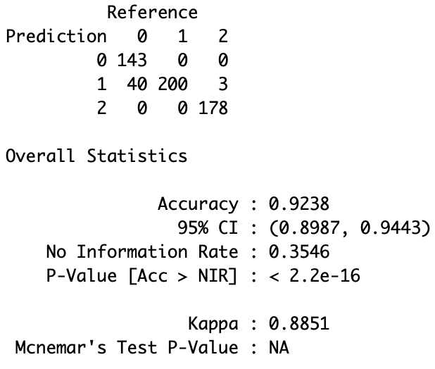
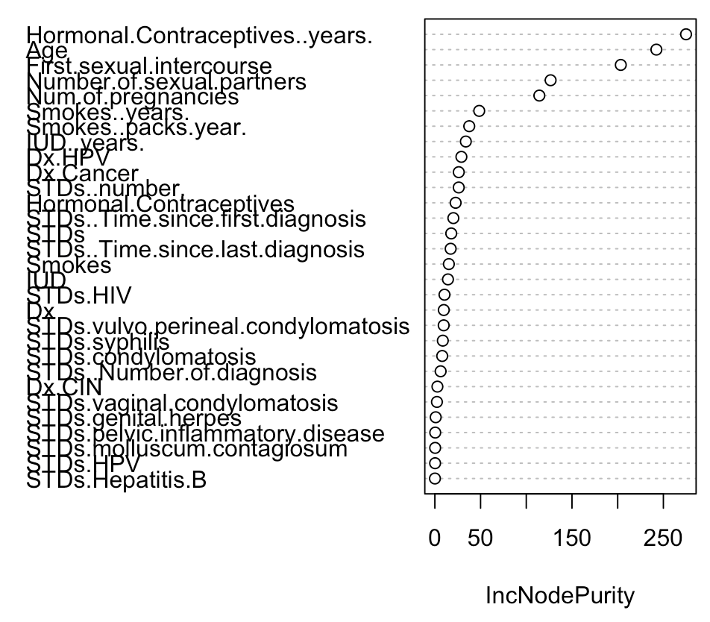
Random forest (With over sampling)
Misclassification rate : 7.6%

Slide 6

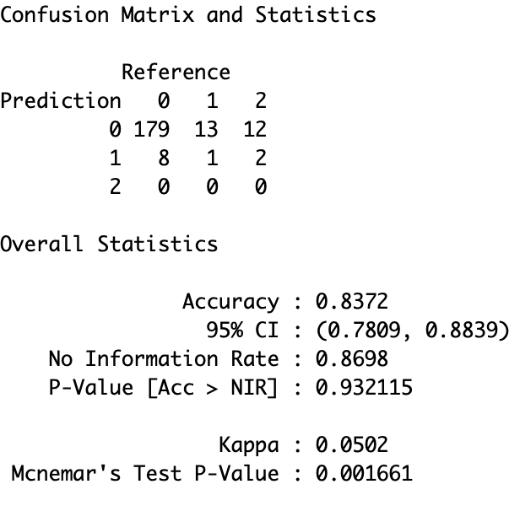
Random forest (Unbalanced)
Misclassification rate : 14.4%

